Slide 1
Toothpaste Dispenser
Designer: Chung-Hau Wang
2017.Sep.01

Slide 2
Outline
Overview
Components
How it works
  The Driving System
  The Dispensing System
  The Positioning System
Discussion
Appendix

Slide 3
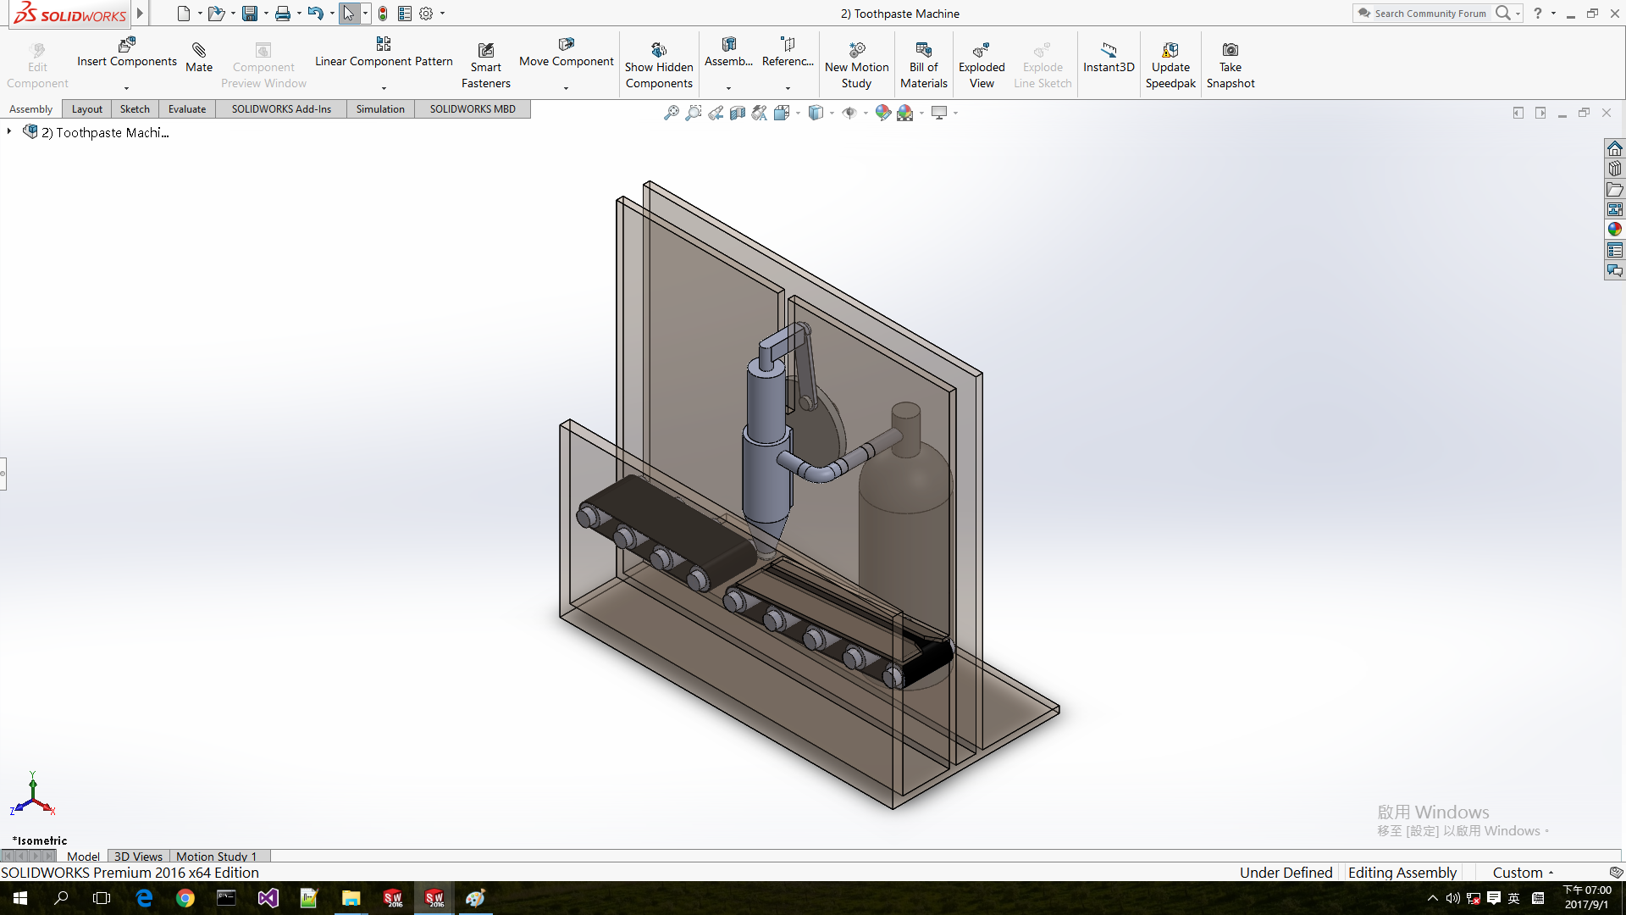
Overview
Dispensing System
Driving System
This machine is designed as neat and compact as possible. It’s:
Simple mechanism.
  Only standard mechanical components and simple linkages are involved.
Easy to maintain.
  Mechanical systems are less order in complexity than electronical systems so that it’s easy to maintain, to debug, and to repair.
Toothpaste Inlet
Conveyor Belt & Positioning System
L×W×H
=0.5×0.25×0.5 (Meters)

Slide 4
Overview
Dispensing System
Driving System
This machine is designed as neat and compact as possible. It’s:
Modular design.
  This machine works as a cell and can be driven with simply one motor whether this machine is mounted online cooperating with other devices; or running itself with manual loading/unloading.
Compatible for manufacturing lines.
  This machine can mount on manufacturing lines with its toothpaste inlet connects to the outlet of toothpaste production.
Toothpaste Inlet
Conveyor Belt & Positioning System
L×W×H
=0.5×0.25×0.5 (Meters)

Slide 5
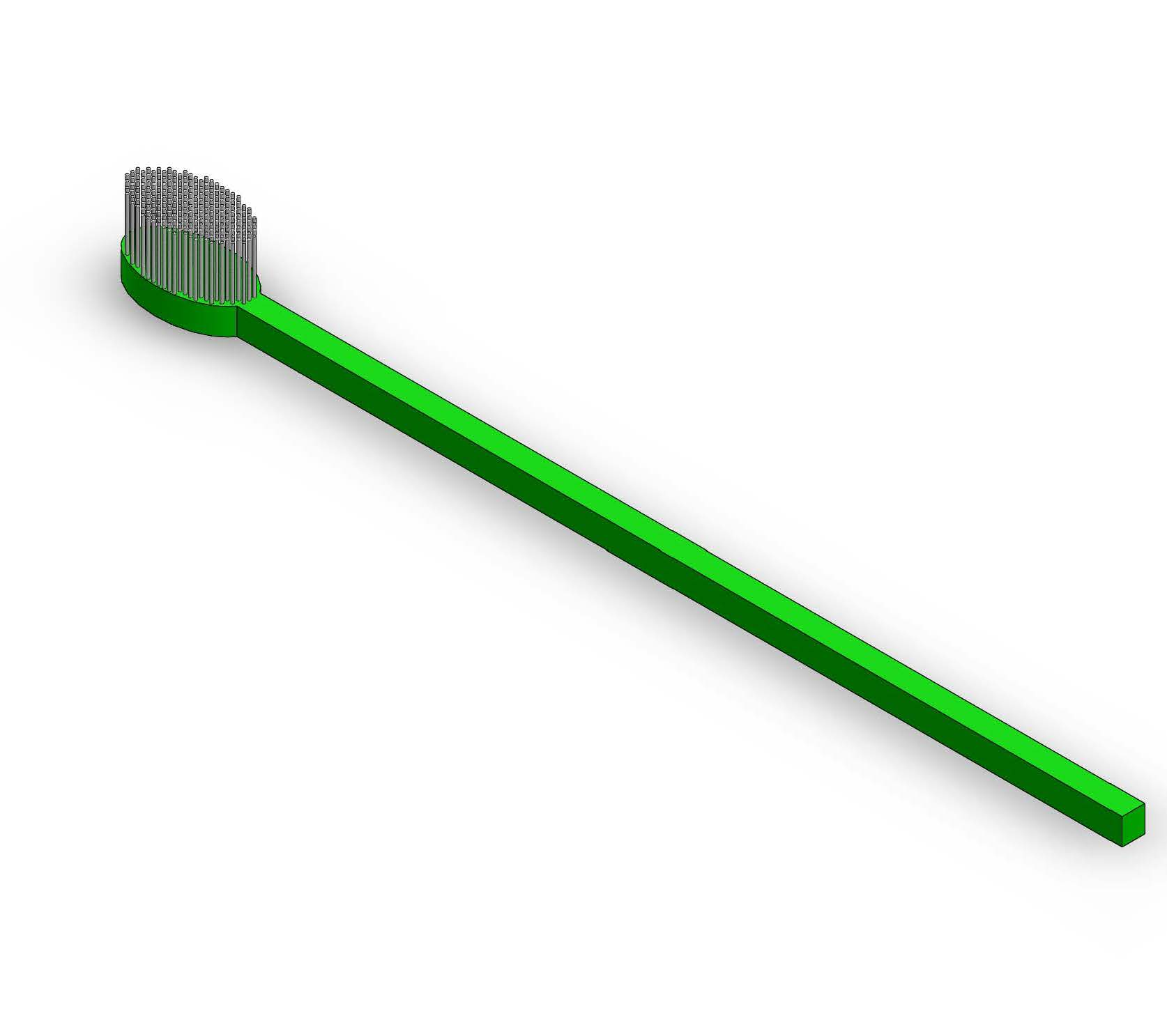
Components
Isometric view of the machine
Toothpastes
Dispensers
Toothbrushes
3.
2.
4.
1.

Slide 6
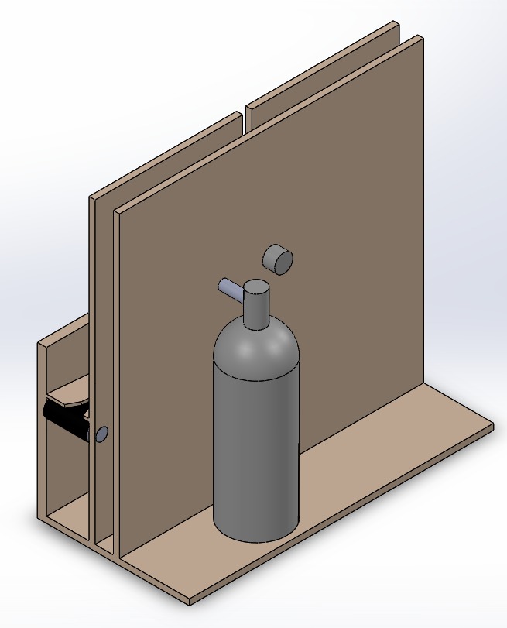
How it works?
Driving Cam
(Where the driving motors mount on)
The Driving System:
  The driving system is simply consisted of one motor mounting on the driving cam as shown.
  Then the driving cam conducts momentum to the squeezing system by linkages.

Slide 7
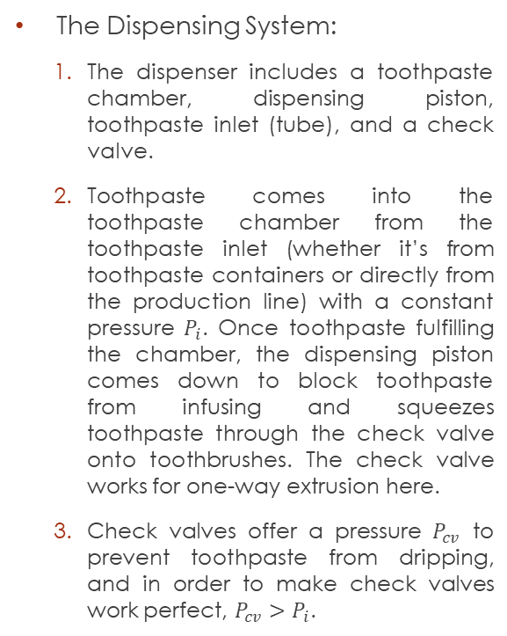
How it works?
Dispensing piston
Toothpaste Inlet
Toothpaste chamber
The Dispensing System:
  The dispenser includes a toothpaste chamber, dispensing piston, toothpaste inlet (tube), and a check valve.
  Toothpaste comes into the toothpaste chamber from the toothpaste inlet (whether it’s from toothpaste containers or directly from the production line) with a constant pressure $P_{i}$. Once toothpaste fulfilling the chamber, the dispensing piston comes down to block toothpaste from infusing and squeezes toothpaste through the check valve onto toothbrushes. The check valve works for one-way extrusion here.
  Check valves offer a pressure $P_{cv}$ to prevent toothpaste from dripping, and in order to make check valves work perfect, $P_{cv}>P_{i}$.
Toothpaste
Check Valve

Slide 8

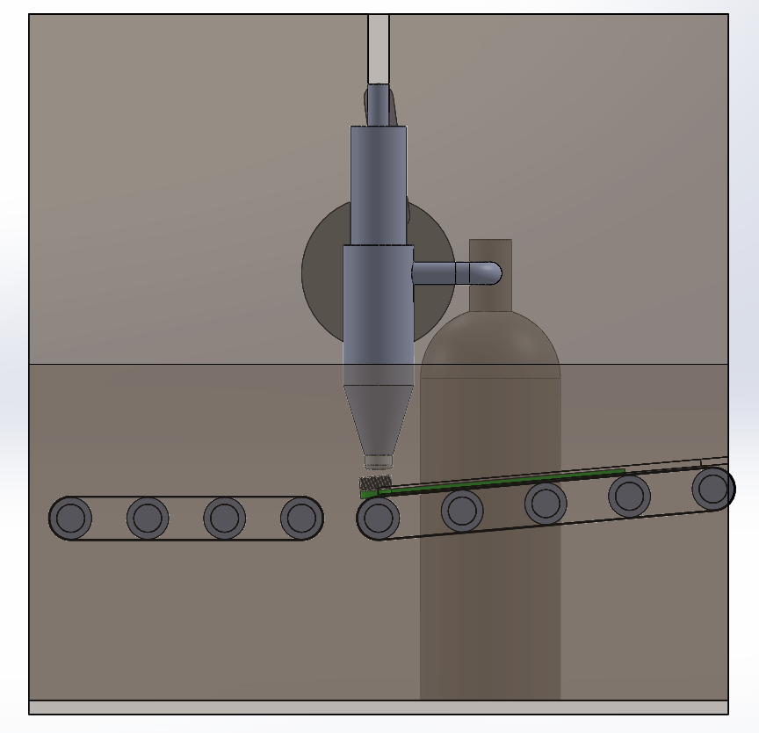
How it works?
The Positioning System:
  Guiding Slot adjusts toothbrushes’ lateral position, and Positioning Bolt positions toothbrushes under Dispenser’s nuzzle.
  …
Positioning Bolt
Guiding Slot
Tilt Angle

Slide 9
How it works?
The Positioning System:
  Tilt Angle helps prevent toothpaste from dripping.
Tilt Angle

Slide 10
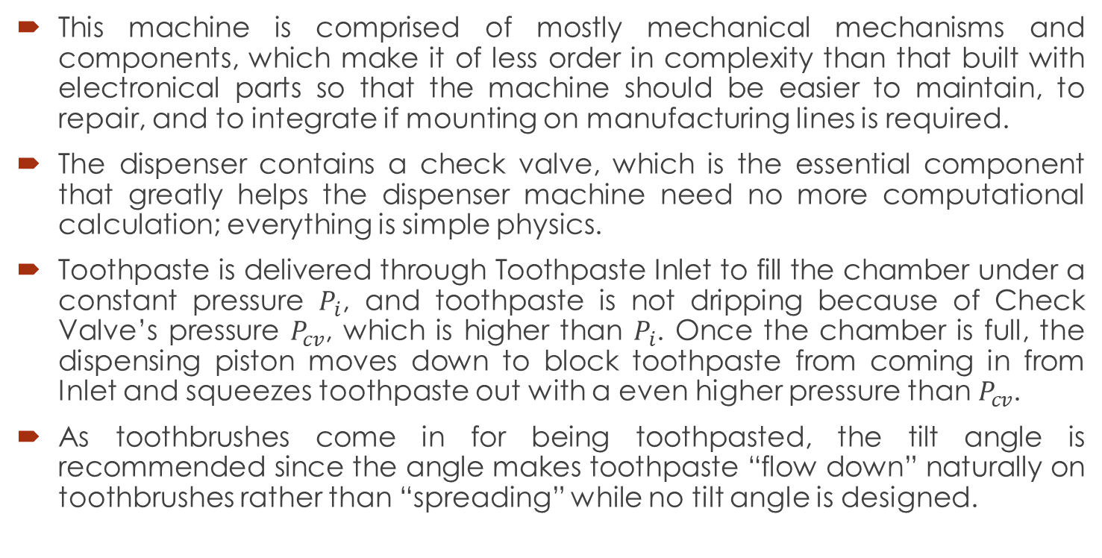
Discussion
This machine is comprised of mostly mechanical mechanisms and components, which make it of less order in complexity than that built with electronical parts so that the machine should be easier to maintain, to repair, and to integrate if mounting on manufacturing lines is required.
The dispenser contains a check valve, which is the essential component that greatly helps the dispenser machine need no more computational calculation; everything is simple physics.
Toothpaste is delivered through Toothpaste Inlet to fill the chamber under a constant pressure $P_{i}$, and toothpaste is not dripping because of Check Valve’s pressure $P_{cv}$, which is higher than $P_{i}$. Once the chamber is full, the dispensing piston moves down to block toothpaste from coming in from Inlet and squeezes toothpaste out with a even higher pressure than $P_{cv}$.
As toothbrushes come in for being toothpasted, the tilt angle is recommended since the angle makes toothpaste “flow down” naturally on toothbrushes rather than “spreading” while no tilt angle is designed.

Slide 11
Appendix
Previous design in 2015.Jan

Slide 12
Outline
Overview
Components
How to use
How it works
  The Driving System
  The Dispensing System
  The Positioning System
Discussion

Slide 13
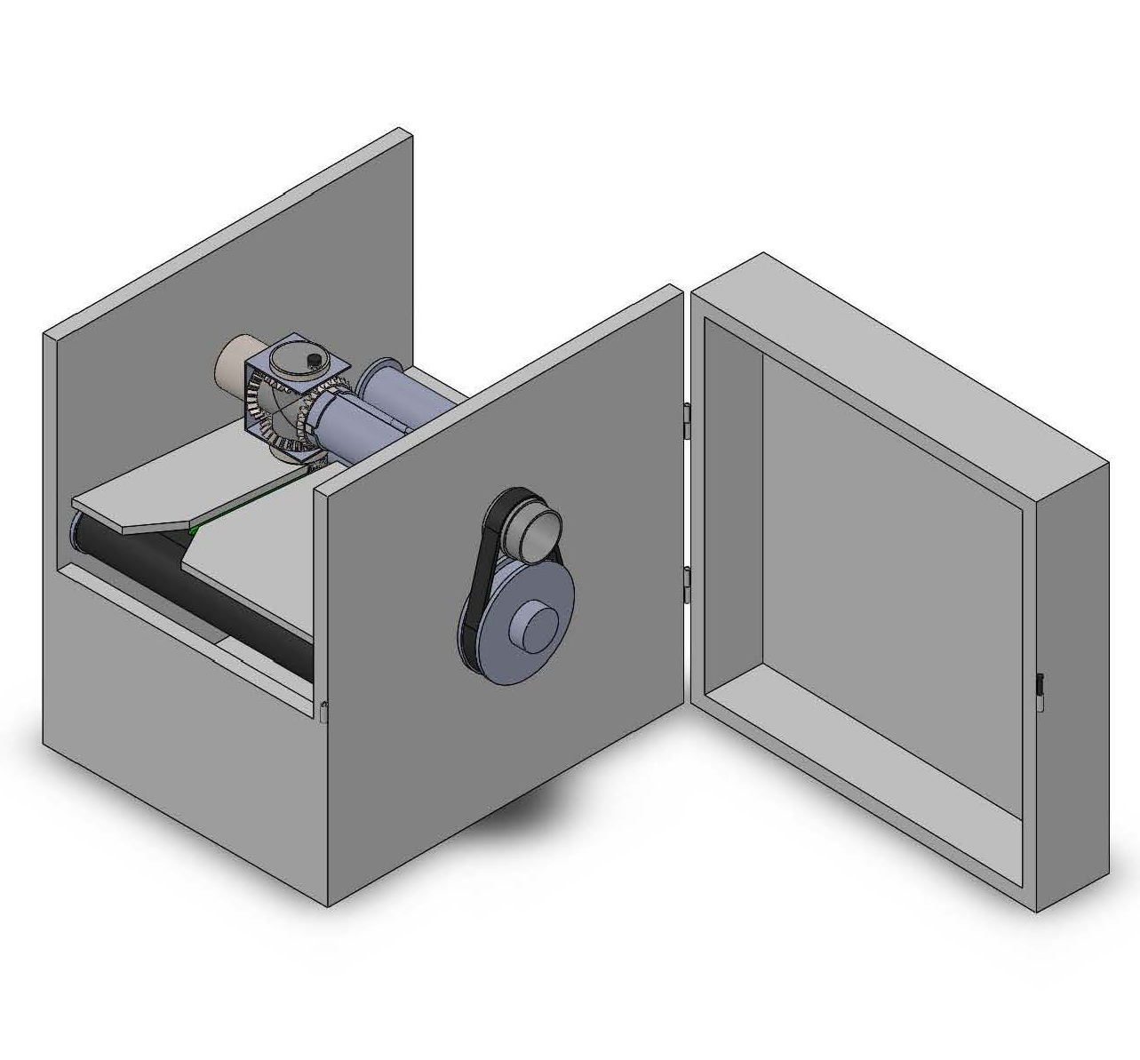
Overview
Dispensing System
This machine is achieved purely by mechanical mechanisms. It’s:
Comprised of general mechanical components only.
  Only gears, cylinders, screws and conveyor belts are involved. These components are general and easy to get.
Easy to repair.
  The dispensing system simply consists of one dispenser nozzle and four gears. The dispensing system will simply have the nozzles and gears replaced to be repaired, and the components are easy to mount and demount as seen.
Driving Pulley
(Power Input)
Conveyor Belt & Positioning System

Slide 14
Overview
Dispensing System
This machine is achieved purely by mechanical mechanisms. It’s:
Modular design.
  The whole machine system only needs one motor attaching to the driving pulley to be actuated so that…
  It has high flexibility in assembling and dissembling.
Highly compatible for production line.
  This machine utilizes conveyor belt transportation. It can be settled at the downstream of toothbrush’s production line or even share the conveyor belt with the production line.
  ...
Driving Pulley
(Power Input)
Conveyor Belt & Positioning System

Slide 15
Overview
Dispensing System
This machine is achieved purely by mechanical mechanisms. It’s:
Highly compatible for production line.
  ... This machine can also be connected to toothpaste production line by directly conducting the toothpaste flow to the dispensing system.
Driving Pulley
(Power Input)
Conveyor Belt & Positioning System

Slide 16
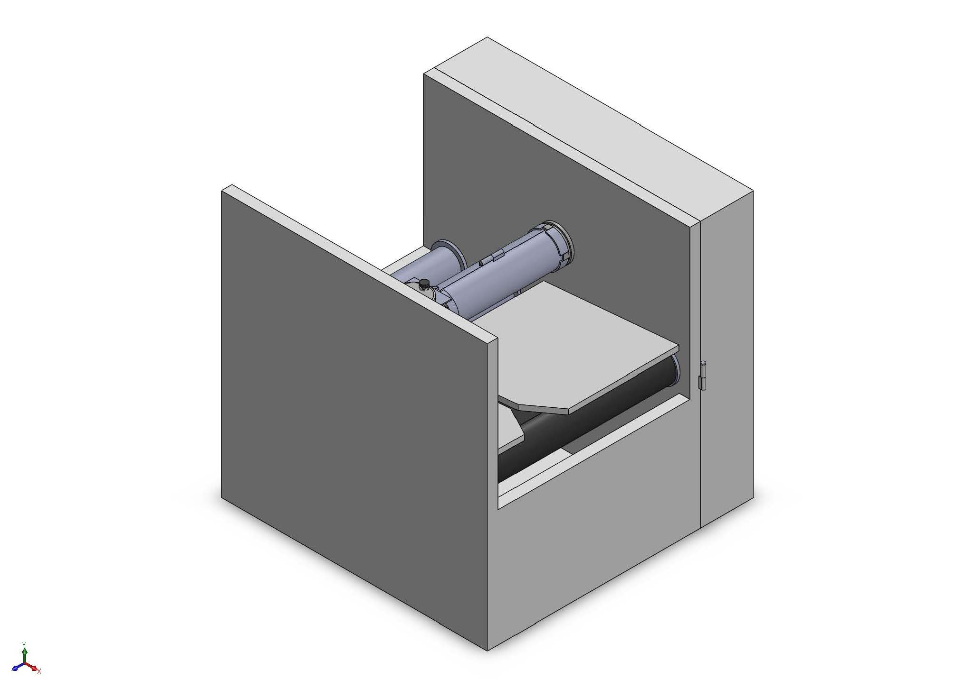
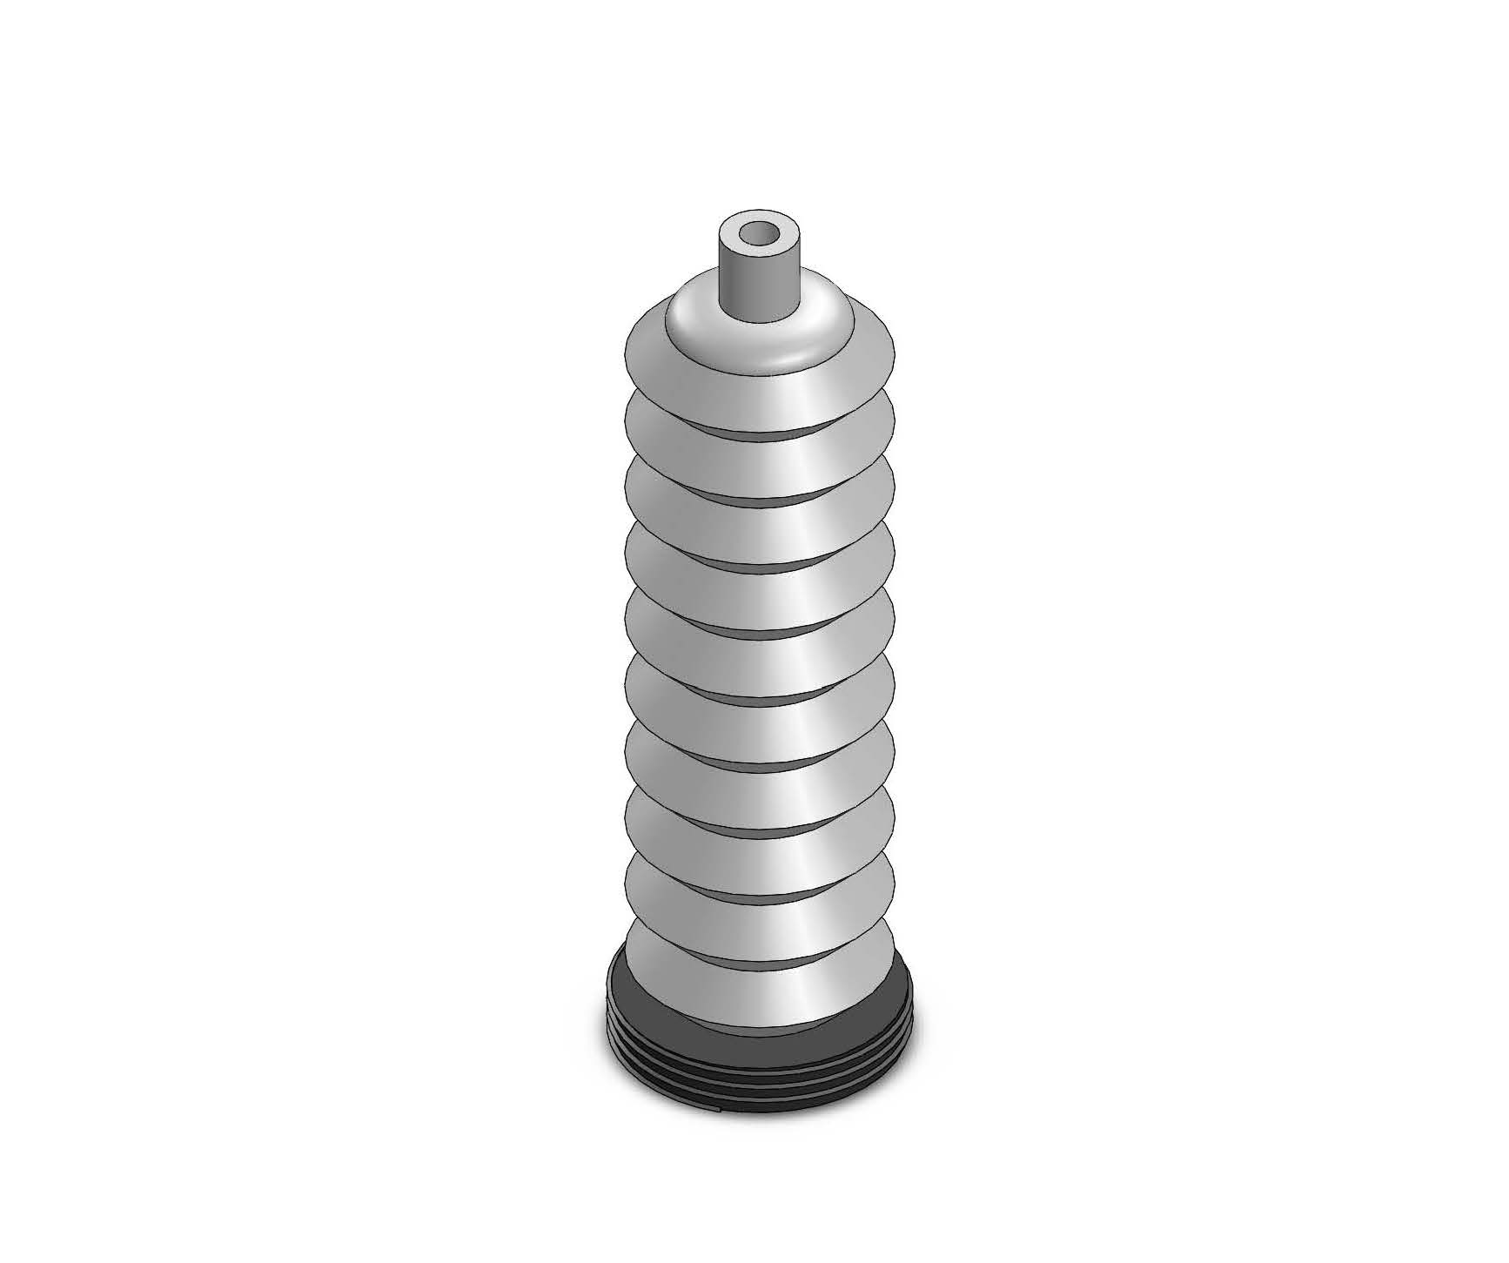
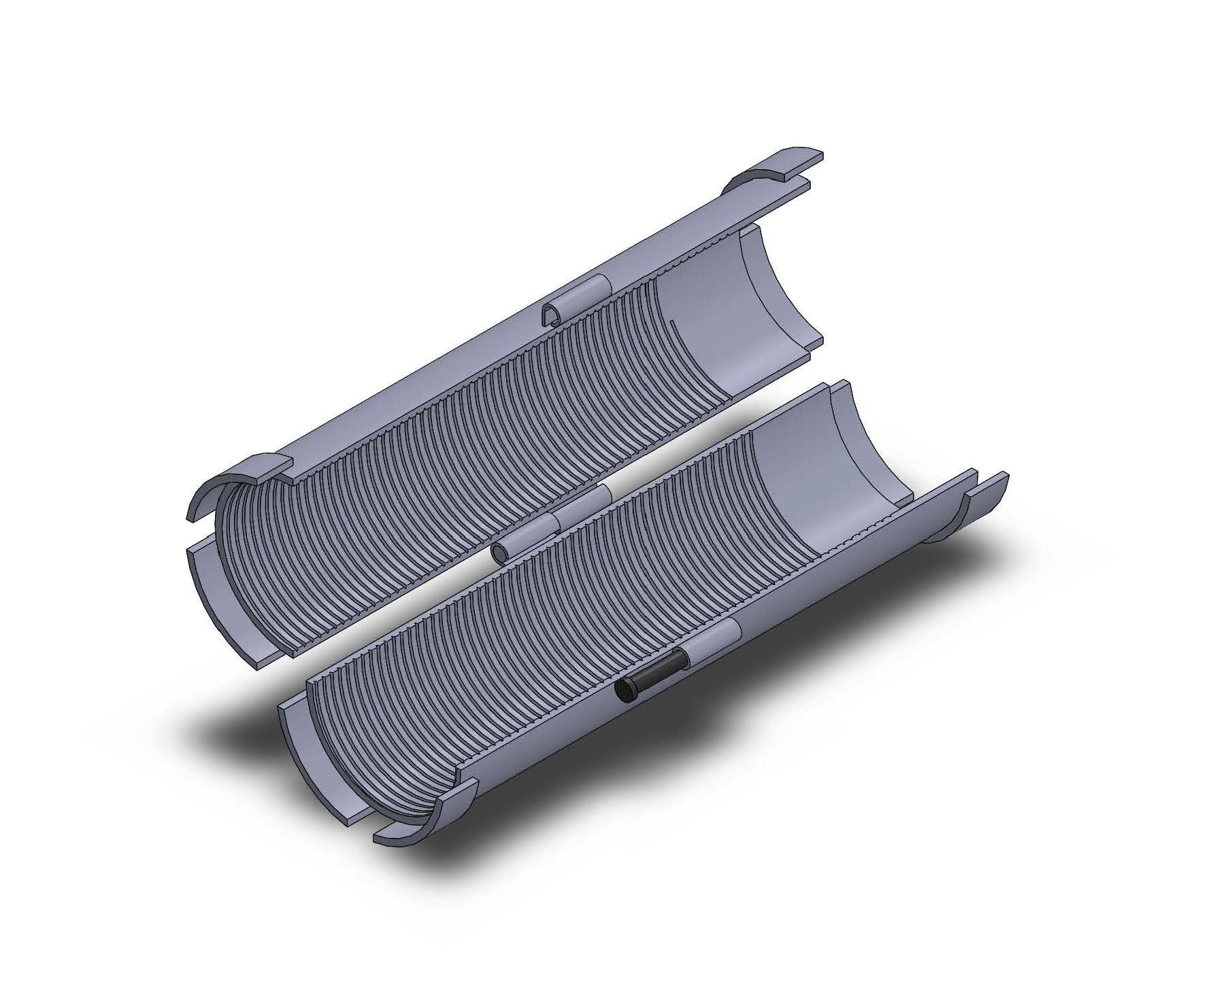
Components
Isometric view of the machine
Toothpastes
Toothpaste Wrap
Toothbrushes
1.
2.
3.
4.

Slide 17
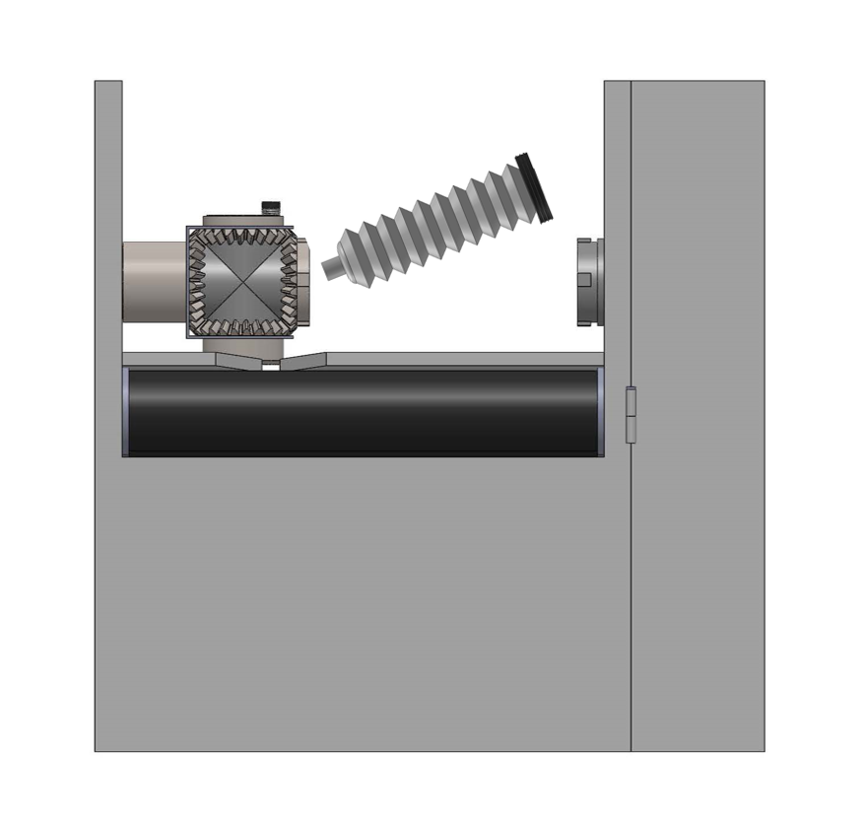
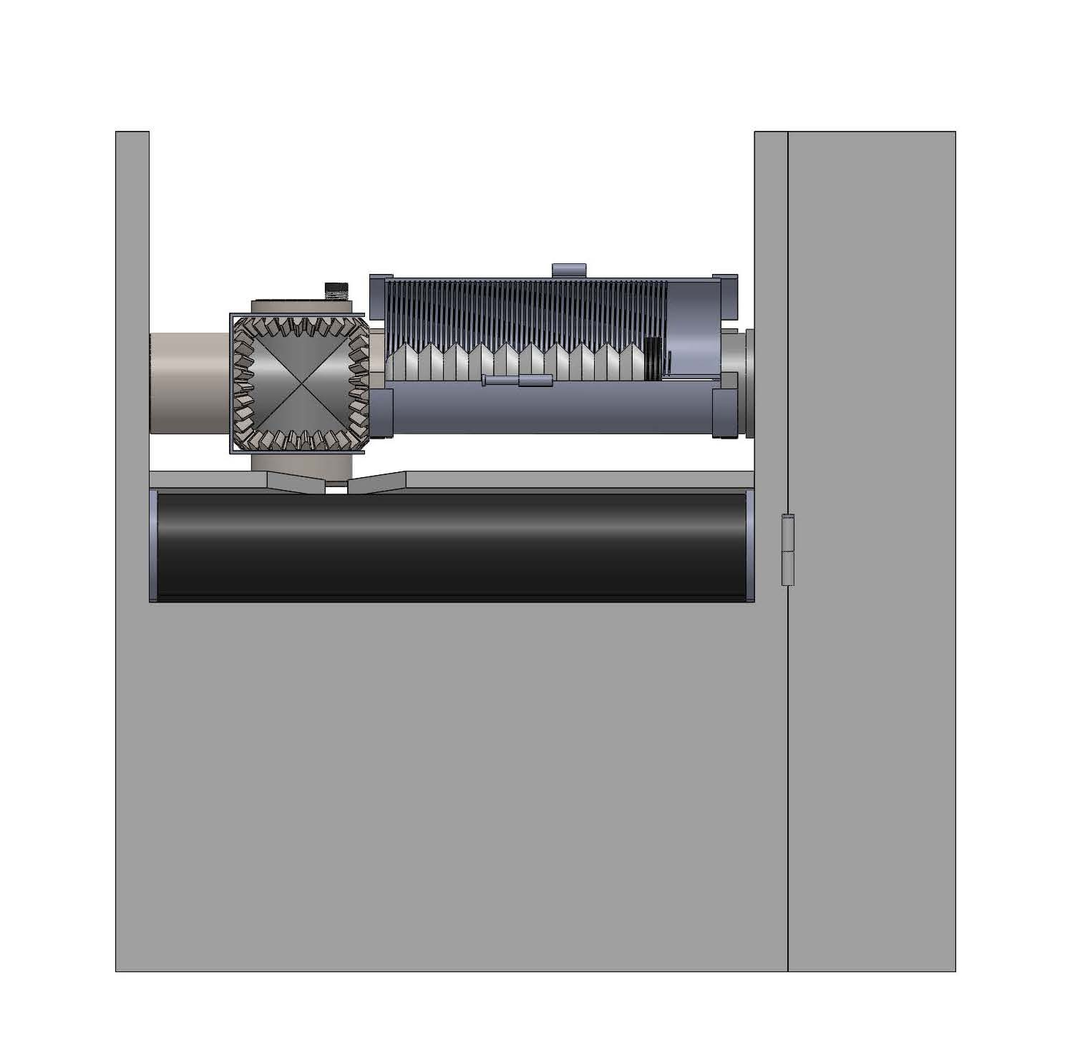
How to use?
Insert toothpastes
Mount the toothpaste wrap
1.
2.

Slide 18
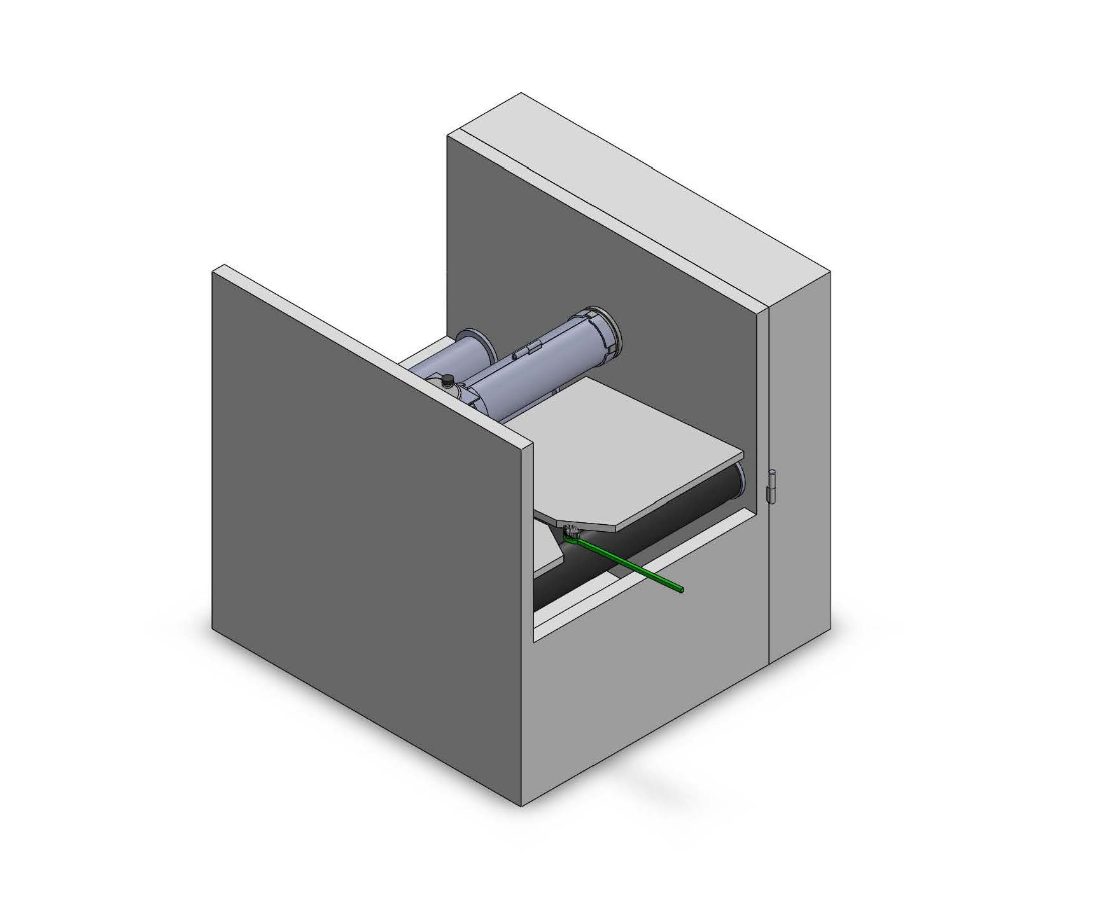
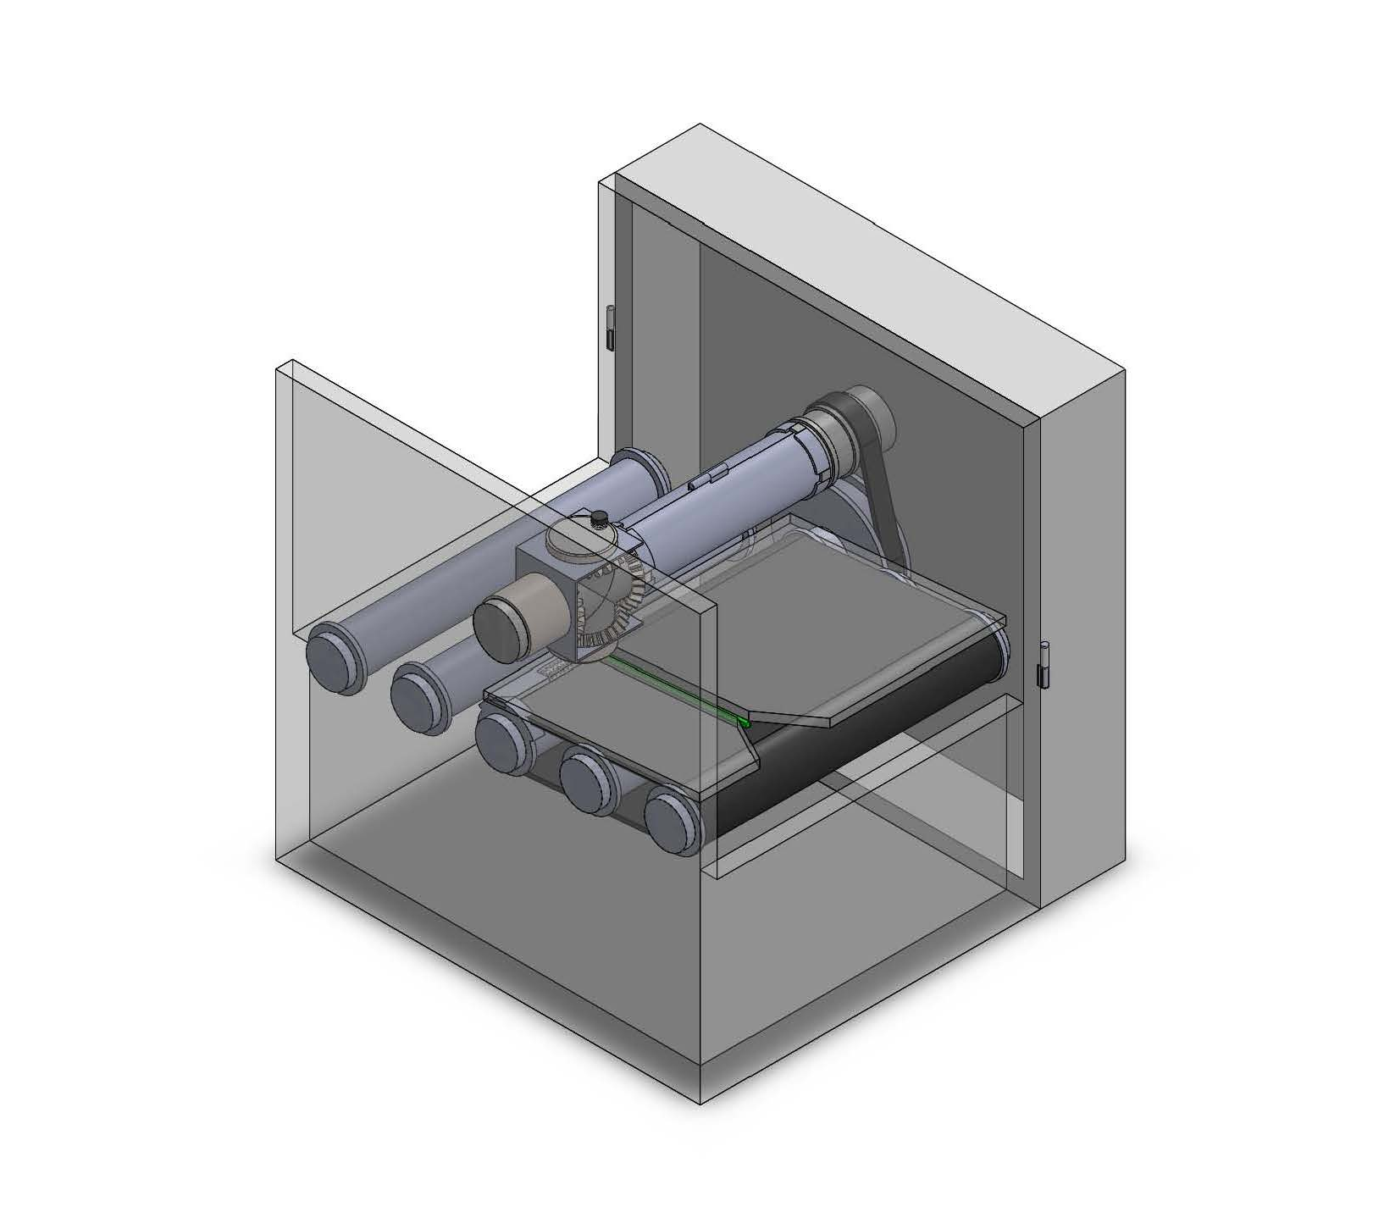
How to use?
Put in toothbrushes
Turn on the machine
3.
4.

Slide 19
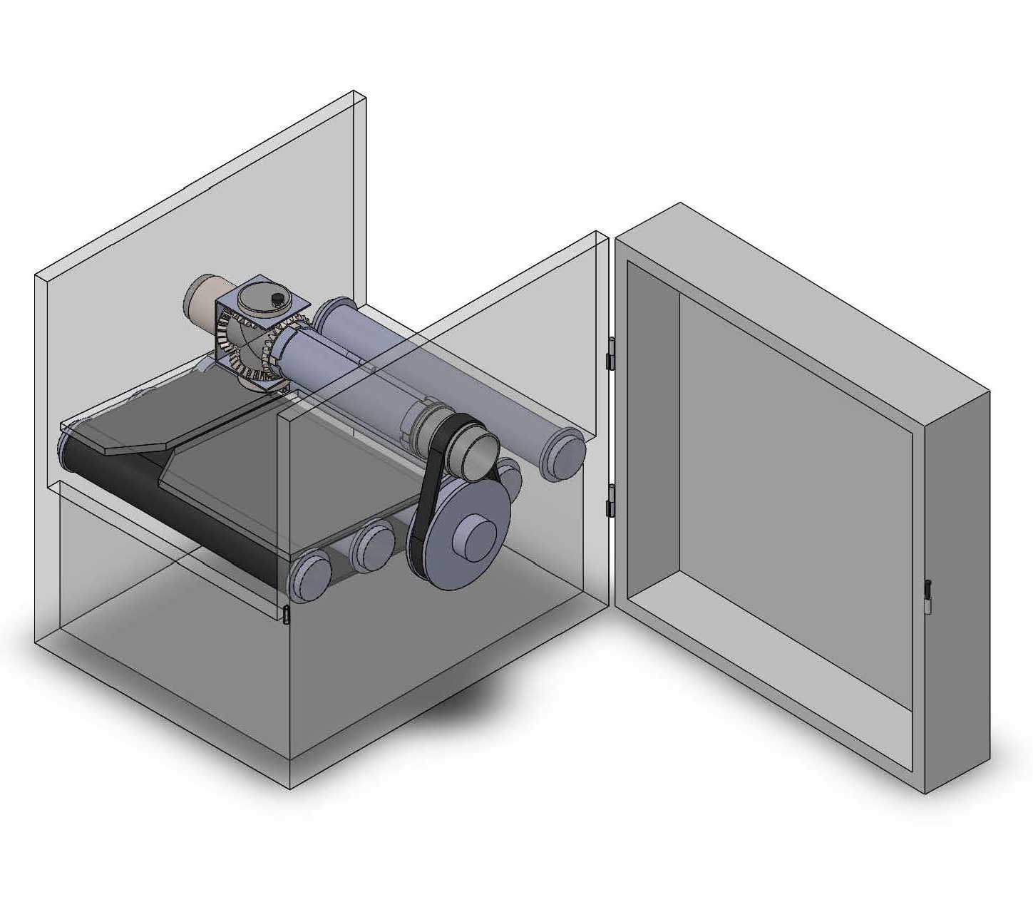
How it works?
The Driving System:
  The driving pulley is attached to motors to drive the transmission pulley and the whole machine.
  The transmission pulley could be associated with the driving pulley by belt, sprocket chain, or gears.
  The radius ratio (or gear ratio) between driving and transmission pulley is appropriately chosen (here the driving to transmission ratio is tentatively 2:1) so that the conveyor belt will let go of one toothbrush when the dispenser nozzle circles one round.
Dispenser Nozzle
Transmission Pulley
Driving Pulley
Conveyor Belt

Slide 20
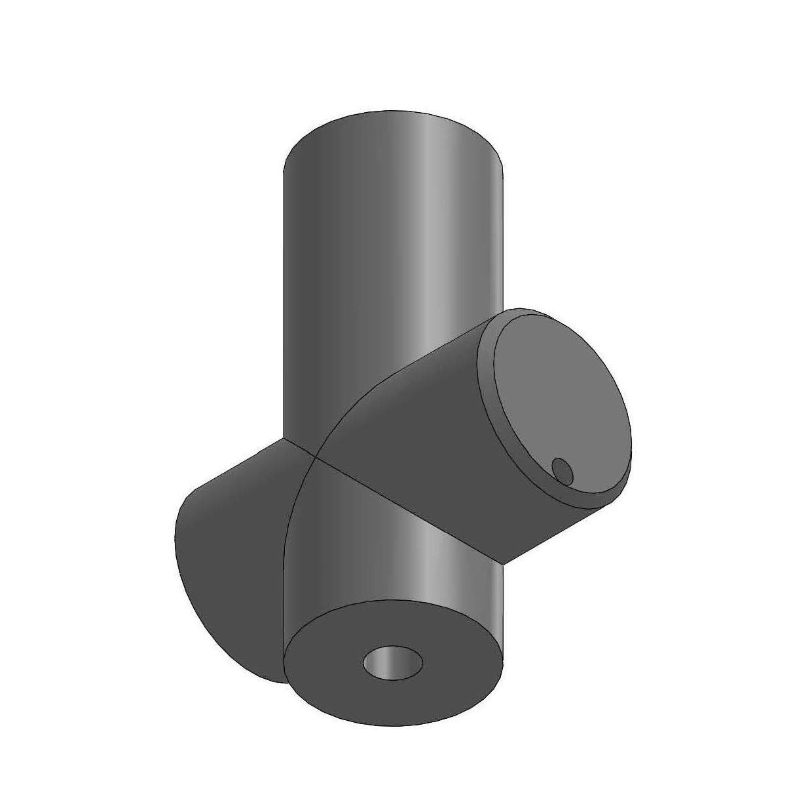
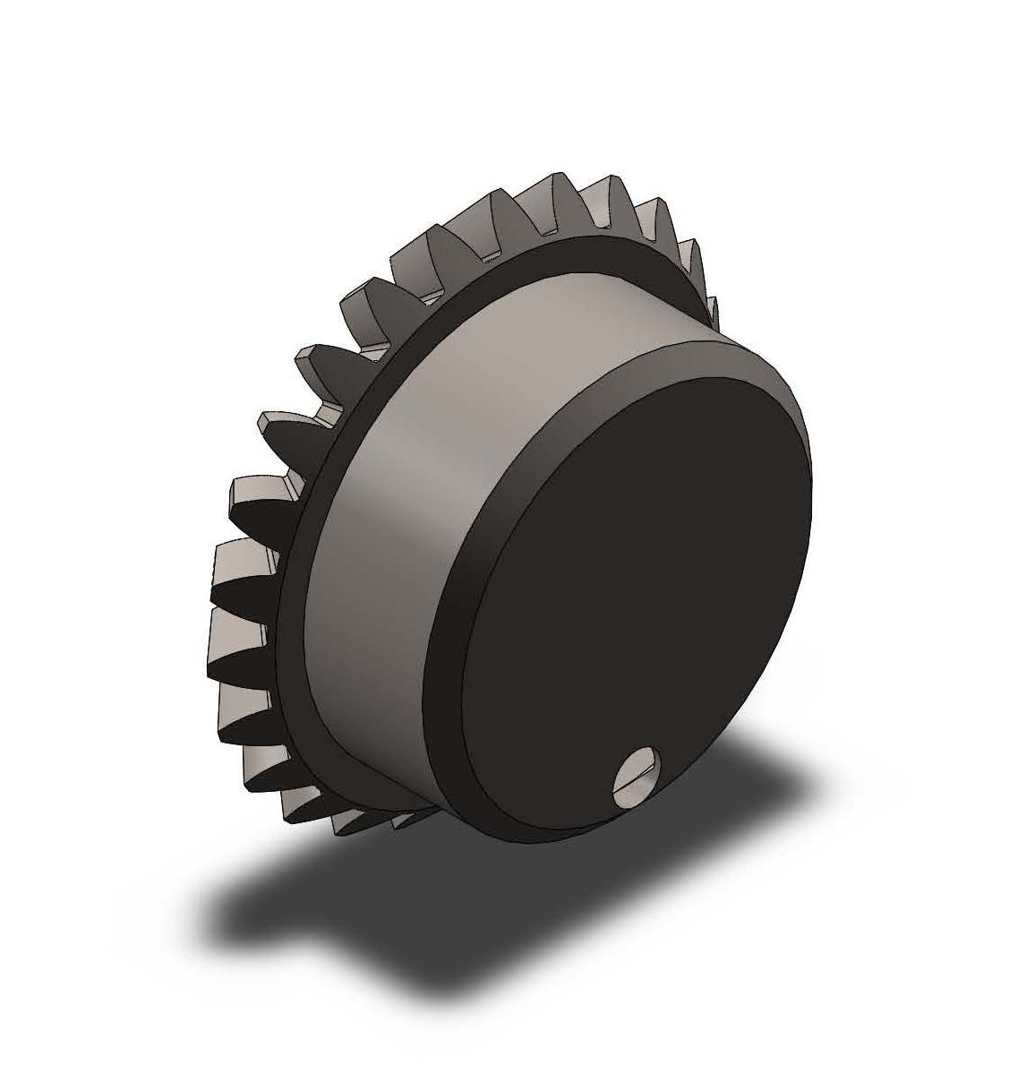
How it works?
Dispenser Nozzle
The Dispensing System:
  Dispenser nozzle has an incoming vent, which connects to the toothpaste’s nozzle; an outgoing vent, which will extrude toothpaste onto the toothbrushes; and on the opposite end to the outgoing vent has a vent connecting to a pressure balancer. dispenser nozzle has four arms to be mounted with the nozzle cap and three gears.
  Nozzle cap has an eccentric vent cut and is mounted to the end of the outgoing vent to work as a valve.
Outgoing Vent
1.
Nozzle Cap
Incoming Vent
Vent Cut
2.

Slide 21
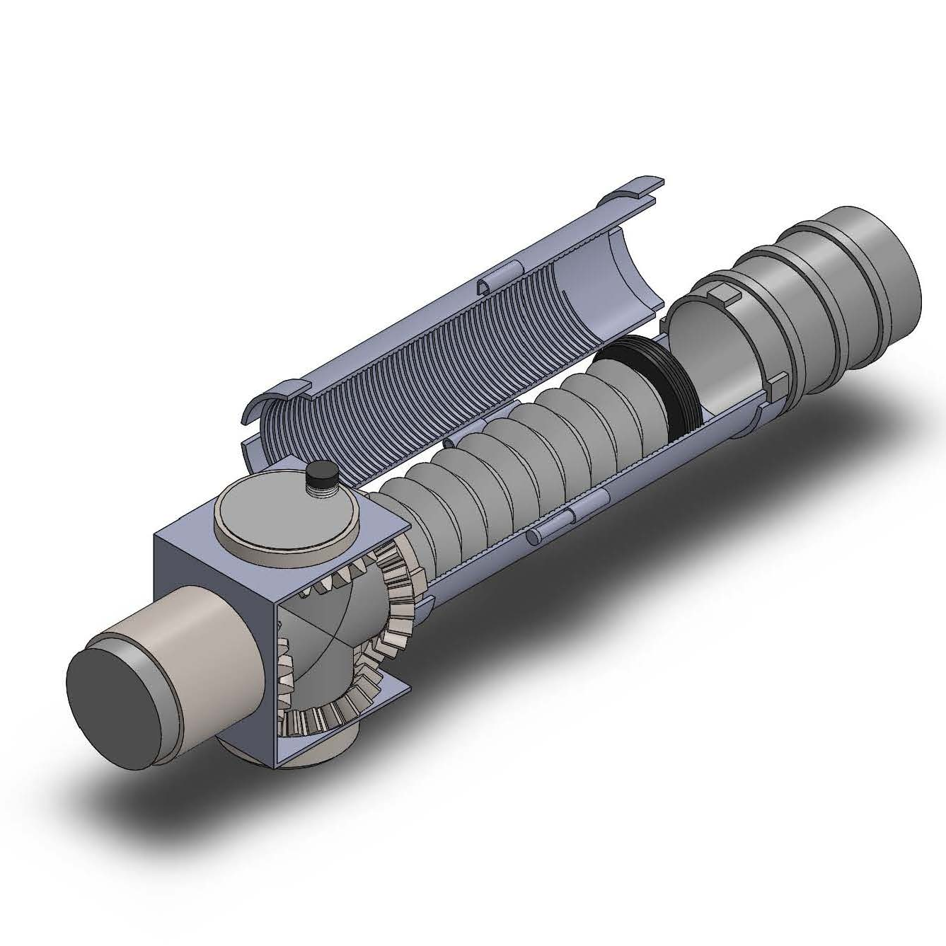
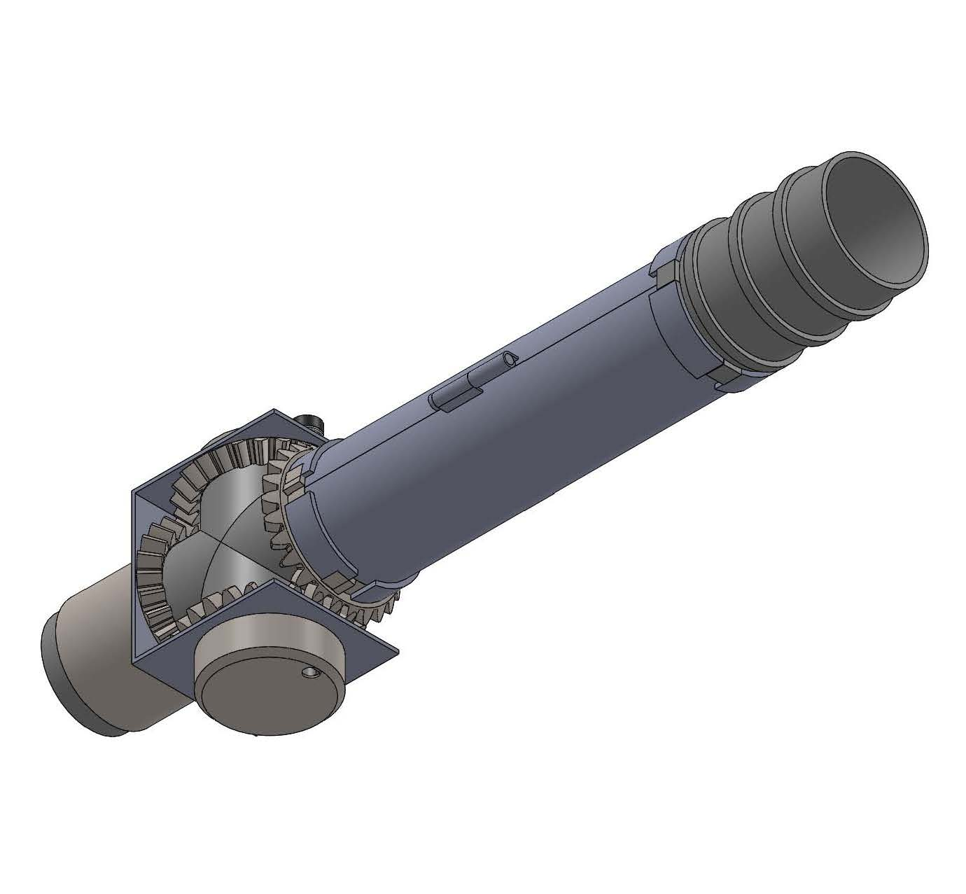
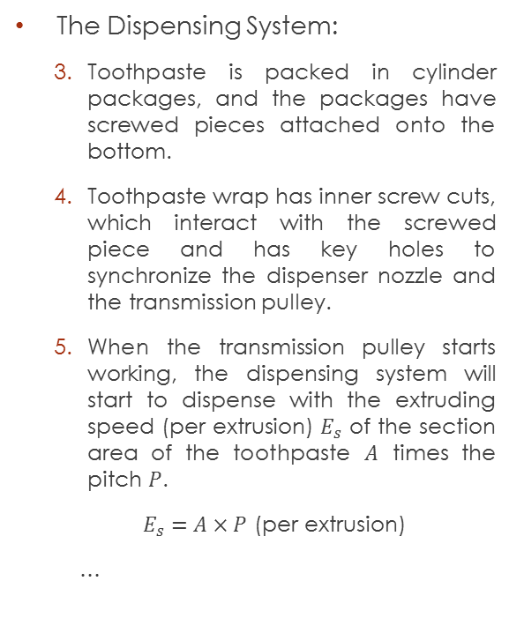
How it works?
Pressure Balancer
Toothpaste Wrap
Transmission Pulley
The Dispensing System:
  Toothpaste is packed in cylinder packages, and the packages have screwed pieces attached onto the bottom.
  Toothpaste wrap has inner screw cuts, which interact with the screwed piece and has key holes to synchronize the dispenser nozzle and the transmission pulley.
  When the transmission pulley starts working, the dispensing system will start to dispense with the extruding speed (per extrusion) $E_{s}$ of the section area of the toothpaste $A$ times the pitch $P$.
  $E_{s}=A×P$ (per extrusion)
  …
Screwed Piece
Toothpaste
Dispenser Nozzle
Fixed Gear
Dispenser Vent

Slide 22
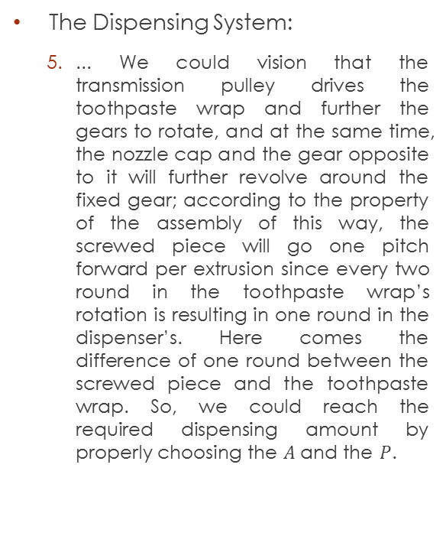
How it works?
Pressure Balancer
Toothpaste Wrap
Transmission Pulley
The Dispensing System:
  ... We could vision that the transmission pulley drives the toothpaste wrap and further the gears to rotate, and at the same time, the nozzle cap and the gear opposite to it will further revolve around the fixed gear; according to the property of the assembly of this way, the screwed piece will go one pitch forward per extrusion since every two round in the toothpaste wrap’s rotation is resulting in one round in the dispenser’s. Here comes the difference of one round between the screwed piece and the toothpaste wrap. So, we could reach the required dispensing amount by properly choosing the $A$ and the $P$.
Screwed Piece
(Synchronized with the dispenser nozzle)
Toothpaste
Dispenser Nozzle
Fixed Gear
Dispenser Vent

Slide 23
How it works?
Pressure Balancer
Toothpaste Wrap
Transmission Pulley
The Dispensing System:
  The dispenser vent will open once per round of dispenser nozzle’s rotation with the gear ratio set to be 1:1, and the pressure balancer will balance the pressure in the dispenser nozzle when the vent is closed.
Screwed Piece
(Synchronized with the dispenser nozzle)
Toothpaste
Dispenser Nozzle
Fixed Gear
Dispenser Vent

Slide 24
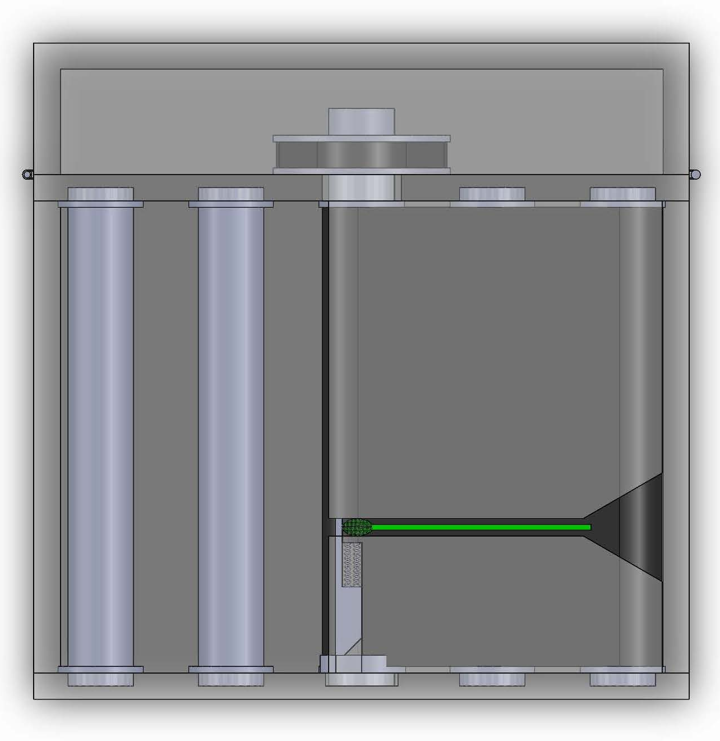
How it works?
The Positioning System:
  Driving roller is mounted with a driving pulley at one end and attached with a cam at the other. Driving roller associates other rollers by the conveyor belt to transport toothbrushes through the path to be toothpasted.
  Blocking bolt is to position the toothbrushes. Blocking bolt interacts with the cam and blocks per every toothpaste extrusion.
Driving Pulley
Blocking Bolt
Driving Roller with Cam

Slide 25
Discussion
Pure mechanical mechanism design offers a sensor-free and control-free system. All the mechanical components are associated with each other by their mechanical properties, and only one general motor will be needed to drive the whole machine. The complexity and further the cost of the machine will be then greatly decreased. Furthermore, by the use of the blocking bolt we’ll still be able to squeeze toothpaste precisely onto the toothbrushes without the need of precision positioning methods.
Rotating dispenser nozzle will distribute toothpaste on the entire bristle surface of the toothbrushes; the distribution can avoid toothpaste dripping.
The dispenser vent should locate eccentrically to the rim in order to make sure the vent opens within the bristle area, closes before getting out of the area, and not to crash into the toothbrushes.

Slide 26
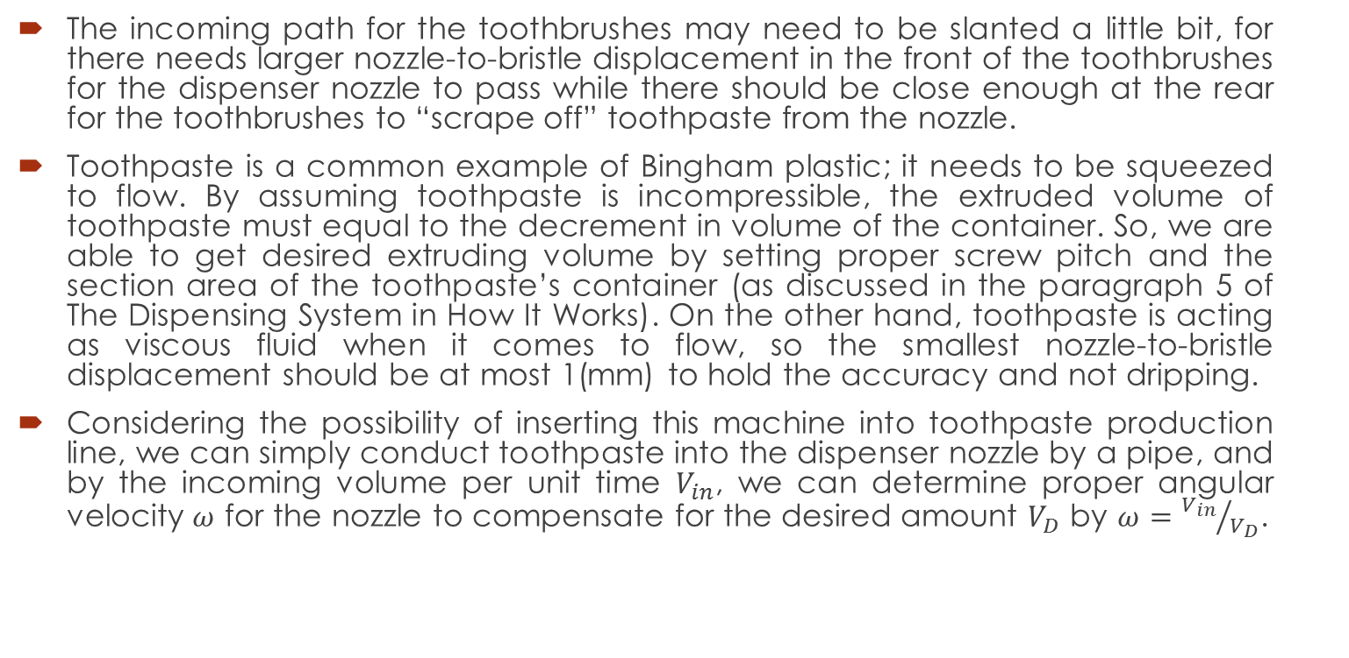
Discussion
The incoming path for the toothbrushes may need to be slanted a little bit, for there needs larger nozzle-to-bristle displacement in the front of the toothbrushes for the dispenser nozzle to pass while there should be close enough at the rear for the toothbrushes to “scrape off” toothpaste from the nozzle.
Toothpaste is a common example of Bingham plastic; it needs to be squeezed to flow. By assuming toothpaste is incompressible, the extruded volume of toothpaste must equal to the decrement in volume of the container. So, we are able to get desired extruding volume by setting proper screw pitch and the section area of the toothpaste’s container (as discussed in the paragraph 5 of The Dispensing System in How It Works). On the other hand, toothpaste is acting as viscous fluid when it comes to flow, so the smallest nozzle-to-bristle displacement should be at most 1(mm) to hold the accuracy and not dripping.
Considering the possibility of inserting this machine into toothpaste production line, we can simply conduct toothpaste into the dispenser nozzle by a pipe, and by the incoming volume per unit time $V_{in}$, we can determine proper angular velocity $ω$ for the nozzle to compensate for the desired amount $V_{D}$ by $ω={V_{in}}/{V_{D}}$.

Slide 27
The End
Thank You

